Slide 1

Programming in Java
Topic: Collections
By
Arvind Kumar
Asst. Professor, LPU

Slide 2
Contents
Introduction
Sets
Comparator
List
Vector
Stack
Queue
Map

Slide 3
Introduction
A collection is simply an object that groups multiple elements into a single unit.
Collections are used to store, retrieve, manipulate, and communicate aggregate data.
java.util package contains all the collection classes and interfaces.

Slide 4
Collection Framework
A collections framework is a unified architecture for representing and manipulating collections.
It is a collection of classes and interfaces.
At the top of collection framework hierarchy, there is an interface, Collection.

Slide 5
Advantages of Collections
Reduces programming effort
Increases program speed and quality
Allows interoperability among unrelated APIs

Slide 6
Blank

Slide 7
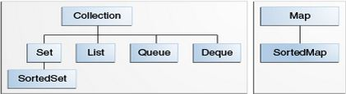
Collection Interfaces
The Java Collections Framework supports two types of containers:
Collection: for storing a collection of elements
Map: for storing key/value pairs

Slide 8
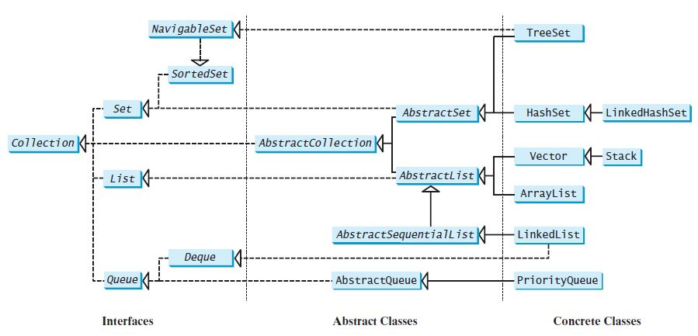

Slide 9
Blank

Slide 10
Collection Interfaces
Sets store a group of non-duplicate elements.
Lists store an ordered collection of elements.
Queues store objects that are processed in first-in, first-out fashion.
Maps are efficient data structures for quickly searching an element using a key.

Slide 11
The AbstractCollection class provides partial implementation for the Collection interface.
It implements all the methods in Collection except the size() and iterator() methods.

Slide 12
Collection
Interface

Slide 13
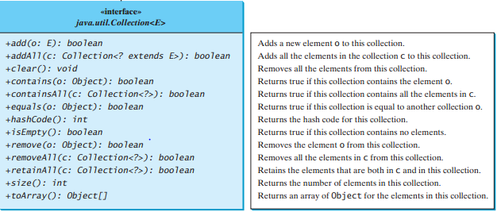
Collection Interface and AbstractCollection class
Notes:
boolean add(E o)

Slide 14
Blank

Slide 15
Iterators

Slide 16
Iterator
There is an Iterable interface at the top of Collection hierarchy.
The Collection interface extends the Iterable interface.
It defines a method which returns an Iterator object for the elements of Collection.
Iterator iterator()
Iterator object is used to traverse the elements in a collection.

Slide 17
Methods of Iterator Interface
boolean hasNext()
Returns true if this iterator has more elements to traverse.
Object next()
Returns the next element from this iterator.
void remove()
Removes the last element obtained using the next method.

Slide 18
Blank

Slide 19
list Interface

Slide 20
ListIterator

Slide 21
ListIterator
ListIterator is derived from Iterator interface and comes with more methods than Iterator.
ListIterator can be used to traverse for List type Objects.
Allows to traverse in both the directions.

Slide 22
ListIterator
A ListIterator has no current element; its cursor position always lies between the element that would be returned by a call to previous() and the element that would be returned by a call to next().
The remove() and set(Object) methods are not defined in terms of the cursor position; they are defined to operate on the last element returned by a call to next() or previous().

Slide 23
ListIterator Methods
public abstract boolean hasPrevious()
public abstract Object previous();
public abstract int nextIndex();
public abstract int previousIndex();
public abstract void set(Object);
public abstract void add(Object);

Slide 24
Blank

Slide 25
List
The List interface extends the Collection interface.
It defines a collection for storing elements in a sequential order.
It define an ordered collection with duplicates allowed.
ArrayList , Vector and LinkedList are the sub-classes of List interface.

Slide 26
Methods of List Interface
boolean add(int index, Object o )
boolean addAll(int index, Collection c )
Object remove(int index)
Object get(int index)
Object set(int index, Object o)
int indexOf(Object o)
int lastIndexOf(Object o)
ListIterator listIterator()
ListIterator listIterator(int start_index)
List subList(int start_index, int end_index): returns a sublist from start_index to end_index-1

Slide 27
Sub-classes of List
ArrayList
LinkedList
Vector
Stack

Slide 28
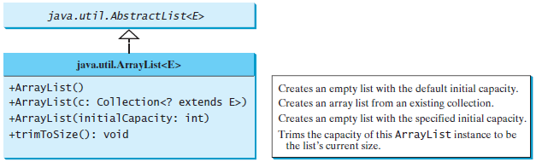
Arrays Lists

Slide 29
Queue

Slide 30
Queue
A queue is a first-in, first-out data structure.
Elements are appended to the end of the queue and are removed from the beginning of the queue.

Slide 31
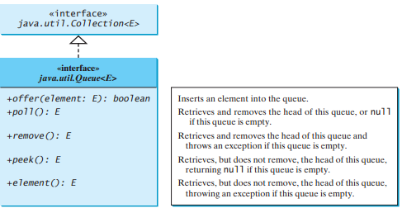
Queue Interface

Slide 32
import java.util.*;
class Demo{
public static void main(String arv[]) {
Queue<Number> queue = new LinkedList<>();
queue.offer(new Integer(10));
queue.offer(new Double(30.0));
queue.offer(new Integer(20));
queue.poll();
queue.poll();
queue.remove();
System.out.println("Queue : "+queue);}}
A. Queue : []
B. Queue : null
C. Queue :
D. NoSuchElementException
Notes:
Ans- A

Slide 33
import java.util.*;
class Demo{
public static void main(String arv[]) {
Queue<Number> queue = new LinkedList<>();
queue.offer(new Integer(10));
queue.offer(new Double(30.0));
queue.offer(new Integer(20));
queue.poll();
queue.poll();
queue.remove();
queue.remove();
System.out.println("Queue : "+queue);}}
A. Queue : []
B. Queue : null
C. Queue :
D. NoSuchElementException
Notes:
Ans- D

Slide 34
import java.util.*;
class Demo{
public static void main(String arv[]) {
Queue<Number> queue = new LinkedList<>();
queue.offer(new Integer(10));
queue.offer(new Double(30.0));
queue.offer(new Integer(20));
queue.poll();
queue.poll();
queue.remove();
System.out.println("Queue : "+queue.peek());}}
A. Queue : []
B. Queue : null
C. Queue : 10
D. NoSuchElementException
Notes:
Ans- B

Slide 35
Deque Interface
Deque supports element insertion and removal at both ends.
The name deque is short for “double-ended queue” and is usually pronounced “deck.”
The Deque interface extends Queue with additional methods for inserting and removing elements from both ends of the queue.
The methods addFirst(e), removeFirst(), addLast(e), removeLast(), getFirst(), and getLast() are defined in the Deque interface.

Slide 36
import java.util.*;
class Demo
{
public static void main(String arv[])
{
Deque<Number> queue = new LinkedList<>();
queue.addFirst(new Integer(10));
queue.addFirst(new Integer(30));
queue.addLast(new Integer(20));
queue.remove();
queue.removeLast();
System.out.println("Queue : "+queue.peek());}}
A. Queue : 20
B. Queue : 30
C. Queue : 10
D. NoSuchElementException
Notes:
Ans-C

Slide 37
Blank

Slide 38
Set Interface

Slide 39
Set Interface
A set is an efficient data structure for storing and processing non-duplicate elements.
Set does not introduce new methods or constants.
The sub-classes of Set (HashSet, TreeSet & LinkedHashSet) ensure that no duplicate elements can be added to the set.

Slide 40
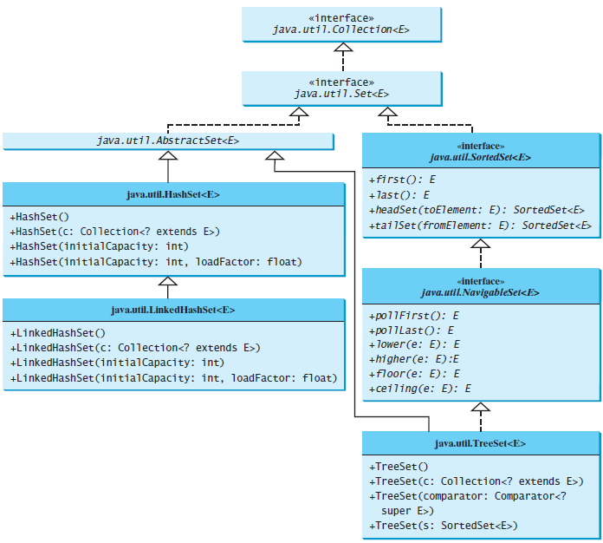

Slide 41
Set Interface
The AbstractSet class provides implementations for the equals() method and the hashCode().
The hash code of a set is the sum of the hash codes of all the elements in the set.
The size() and iterator() are not implemented in the AbstractSet class.

Slide 42
SortedSet Interface
SortedSet is a subinterface of Set, which guarantees that the elements in the set are sorted.
It provides the methods first() and last() for returning the first and last elements in the set.
headSet(toElement) and tailSet(fromElement) for returning a portion of the set whose elements are less than toElement and greater than or equal to fromElement.

Slide 43
NevigableSet Interface
NavigableSet extends SortedSet.
It provides navigation methods lower(e), floor(e), ceiling(e), and higher(e) that return elements respectively less than, less than or equal, greater than or equal, and greater than a given element and return null if there is no such element.
The pollFirst() and pollLast() methods remove and return the first and last element in the tree set, respectively.

Slide 44
TreeSet
TreeSet implements the NavigableSet interface.
We can add objects into a tree set as long as they can be compared with each other.
Constructor:
TreeSet()
TreeSet(Collection c)
TreeSet(Comparator c)
TreeSet(SortedSet s)

Slide 45
Comparator Interface
java.util.Comparator interface provides two abstract methods:
public interface Comparator<T>
{
public abstract int compare(T ob1, T ob2);
public abstract boolean equals(java.lang.Object);
…
}

Slide 46
Blank

Slide 47
Comparable Interface
java.lang.Comparable interface provides only one abstract method:
public interface Comparable<T>
{
public abstract int compareTo(T ob);
}

Slide 48
Blank

Slide 49
Implementing TreeSet
import java.util.*;
public class SortSetExample {
public static void main(String arv[]){
Set<Integer> tree = new TreeSet<Integer>();
tree.add(3);
tree.add(1);
tree.add(2);
System.out.println("treeSet : "+treeSet);
}
}

Slide 50
Blank

Slide 51
Implementing TreeSet with Comparator sorting in descending order
import java.util.*;
public class SortSetExample {
public static void main(String arv[]){
Set<Integer> tree = new TreeSet<Integer>(new Comparator<Integer>() {
public int compare(Integer o1, Integer o2) {
return o2.compareTo(o1);
}
});
tree.add(3); tree.add(1); tree.add(2);
System.out.println("treeSet : "+tree);
}
}

Slide 52
Implementing TreeSet with Comparable
import java.util.*;
class Employee implements Comparable<Employee>{
String name; String id;
public Employee(String name, String id) {
this.name = name; this.id = id;
}
public int compareTo(Employee otherEmployee) {
return this.name.compareTo(otherEmployee.name);
}
public String toString() {
return "Employee{" + "name=" + name + ", id=" + id + '}';
}
}

Slide 53
Implementing TreeSet with Comparable sorting in ascending order
public class SortSetExample {
public static void main(String arv[]){
Employee emp1=new Employee("sam","4");
Employee emp2=new Employee("amy","2");
Employee emp3=new Employee("brad","1");
Set<Employee> treeSet = new TreeSet<Employee>();
treeSet.add(emp1);
treeSet.add(emp2);
treeSet.add(emp3);
System.out.println("treeSet : "+treeSet);
}
}

Slide 54
Blank

Slide 55
MAP Interface

Slide 56
MAP
A map is a container object that stores a collection of key/value pairs.
Keys are like indexes in List but in Map, the keys can be any objects.
A map cannot contain duplicate keys.
Each key maps to one value.
A key and its corresponding value form an entry stored in a map.

Slide 57
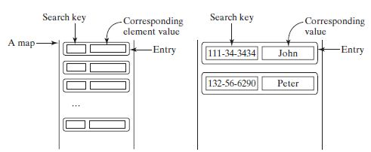
MAP

Slide 58
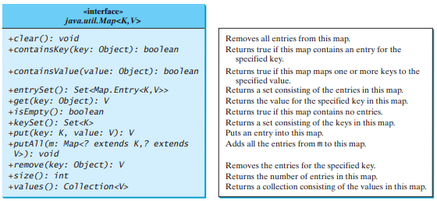
MAP Methods

Slide 59
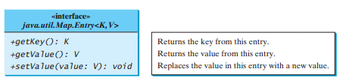
MAP.Entry Methods

Slide 60
Blank

Slide 61
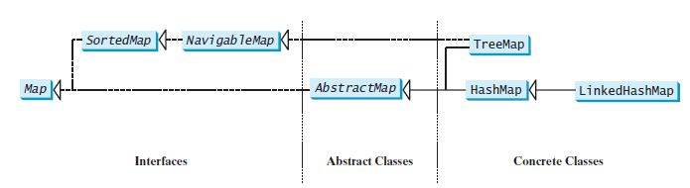
MAP Class Hierarchy

Slide 62
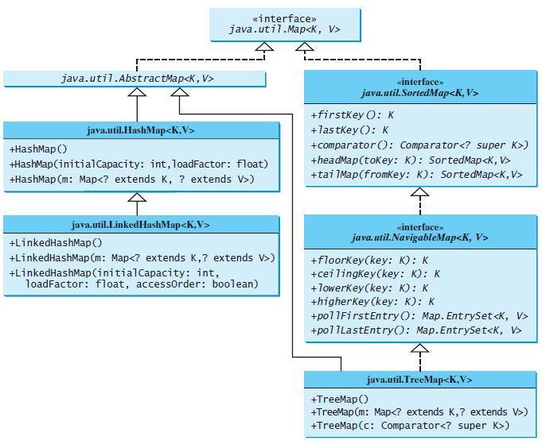
MAP
Ravi Kant Sahu, Asst. Professor @ Lovely Professional University, Punjab (India)

Slide 63
Blank

Slide 64
HashMap
The HashMap class is efficient for locating a value, inserting an entry, and deleting an entry.
The entries in a HashMap are not ordered.

Slide 65
Blank
Which of these method Map class is used to obtain an element in the map having specified key?
a) search()
b) get()
c) set()
d) look()
Notes:
Ans- B

Slide 66
Blank
Which of these methods can be used to obtain set of all keys in a map?
a) getAll()
b) getKeys()
c) keyall()
d) keySet()
Notes:
Ans- D

Slide 67
Blank
Which of these method is used to remove all keys/values pair from the invoking map?
a) delete()
b) remove()
c) clear()
d) removeAll()
Notes:
Ans- C

Slide 68
Blank
What will be the output of the following Java program?
import java.util.*;
class Maps
{
public static void main(String args[])
{
HashMap obj = new HashMap();
obj.put("A", new Integer(1));
obj.put("B", new Integer(2));
obj.put("C", new Integer(3));
System.out.println(obj);
}
}
a) {A 1, B 1, C 1}
b) {A, B, C}
c) {A-1, B-1, C-1}
d) {A=1, B=2, C=3}
Notes:
Ans- D

Slide 69
Blank
What will be the output of the following Java program?
import java.util.*;
class Maps
{
public static void main(String args[])
{
HashMap obj = new HashMap();
obj.put("A", new Integer(1));
obj.put("B", new Integer(2));
obj.put("C", new Integer(3));
System.out.println(obj.keySet());
}
}
a) [A, B, C]
b) {A, B, C}
c) {1, 2, 3}
d) [1, 2, 3]
Notes:
Ans- A

Slide 70
Blank
What will be the output of the following Java program?
import java.util.*;
class Maps
{
public static void main(String args[])
{
HashMap obj = new HashMap();
obj.put("A", new Integer(1));
obj.put("B", new Integer(2));
obj.put("C", new Integer(3));
System.out.println(obj.get("B"));
}
}
a) null
b) 2
c) Compilation Error
d) Runtime Error
Notes:
Ans- B

Slide 71
Blank
What will be the output of the following Java program?
import java.util.*;
class Maps
{
public static void main(String args[])
{
TreeMap obj = new TreeMap();
obj.put("A", new Integer(1));
obj.put("B", new Integer(2));
obj.put("C", new Integer(3));
System.out.println(obj.entrySet());
}
}
a) [A, B, C]
b) [1, 2, 3]
c) {A=1, B=2, C=3}
d) [A=1, B=2, C=3]
Notes:
Ans- D

Slide 72
Let’s Do It?
WAP to implement a method which accepts an arraylist containing duplicate values and returns a Collection having unique elements only.
public <T extends Number> Collection removeDuplicate(ArrayList<T> al)

Slide 73
Blank

Slide 74
Let’s Do It?
WAP to create a class Student with attributes name and cgpa. Add at least 5 Student objects in an appropriate collection such that they are sorted in descending order on the basis of their cgpa.
Display names of all the students who are eligible for Verizon placement drive. (Eligibility: cgpa >=7.5 )

Slide 75
Blank

Slide 76
Let’s Do It?
WAP to create a class Employee with attributes name, designation and salary. Add at least 5 Employee objects in an appropriate collection such that they are sorted in descending order of their salary.
Display names of all the employees who have salary greater than 50000.

Slide 77
Blank

Slide 78


Slide 79
Blank

